Slide 1
Chapter 09

Slide 2
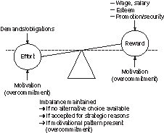
Figure 1 The model of effort-reward imbalance at work.
Modified from Ref. 1.

